Slide 1
Online Real State Business
Developed by Mehedee Hasan
Round 37
ESAD J2EE
IDB-BISEW Scholarship Project
Supervised by MD. Rajaul Islam
Instructor
ESAD J2EE
IDB-BISEW Scholarship Project

Slide 2
ABSTRACT
Our project “ONLINE REAL ESTATE BUSINESS” is related to online application of estate. Real estate management system is advanced solution for his/her estate problem. User shows all the properties of Buyer that are secure & verify & send them to the Builder. Real System Buy the property &verify them and the online service is provided by us free of charge. Here registration is also free of cost. So user can registration by using Real System then Buy the property & verify them. After few hours or days our guys put the estate solution.

Slide 3
Project Objectives
The system should have a login. A login box should appear when the system is invoked. The Admin should have all the type of authority. The Admin should maintain property .Admin identify property type as it is residential or commercial property. The Admin user can inform their agents for regarding to property and update the information regarding property and cancellation of property or changing buyer choice. The user should book the property for sell or rent with detail of property. The system is very useful for the companies or builders that can post and edit their properties and their personal info and admin can monitor records of all of them. The system is also useful which also keeps track of Account details of buyers and Investors and also RES Industry.

Slide 4
Project Goals
Planned approach towards working: - The working in the organization will be well planned and organized. The data will be stored properly in data stores, which will help in retrieval of information as well as its storage.
Accuracy: - The level of accuracy in the proposed system can not be decided. Because here user buy and another user build the home. There is no guarantee.
Reliability: - The reliability of the proposed system will be high due to the above stated reasons. The reason for the increased reliability of the system is that now there would be proper storage of information.

Slide 5
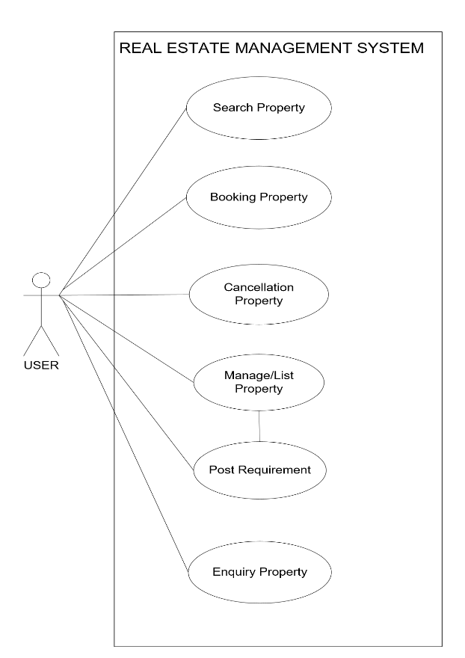
Use Case Diagram

Slide 6
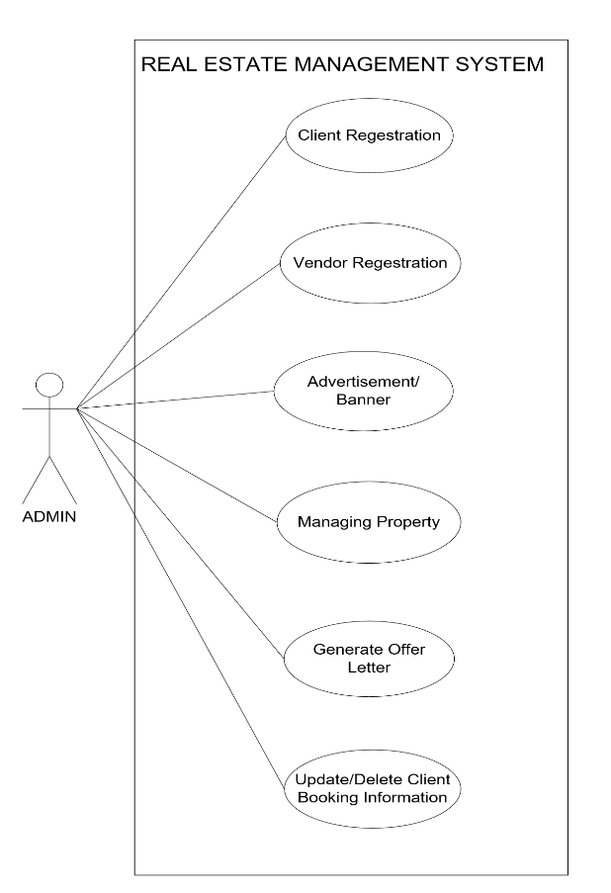
Use Case Diagram

Slide 7
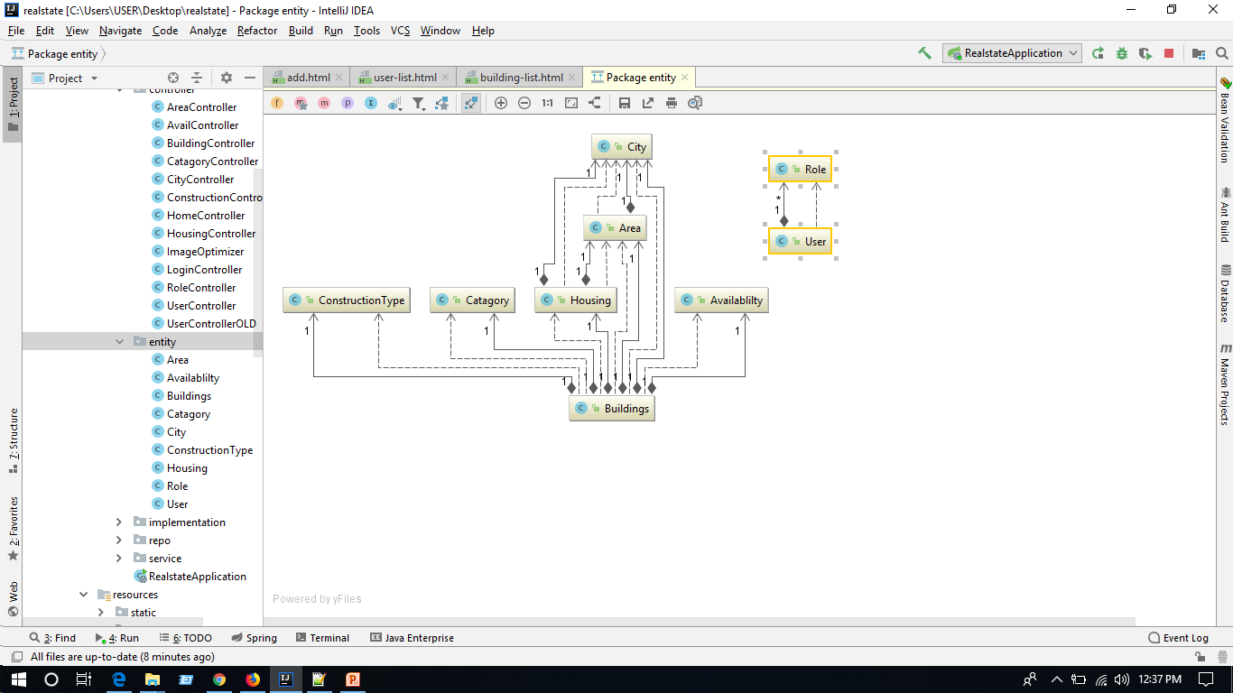
Class Diagram

Slide 8
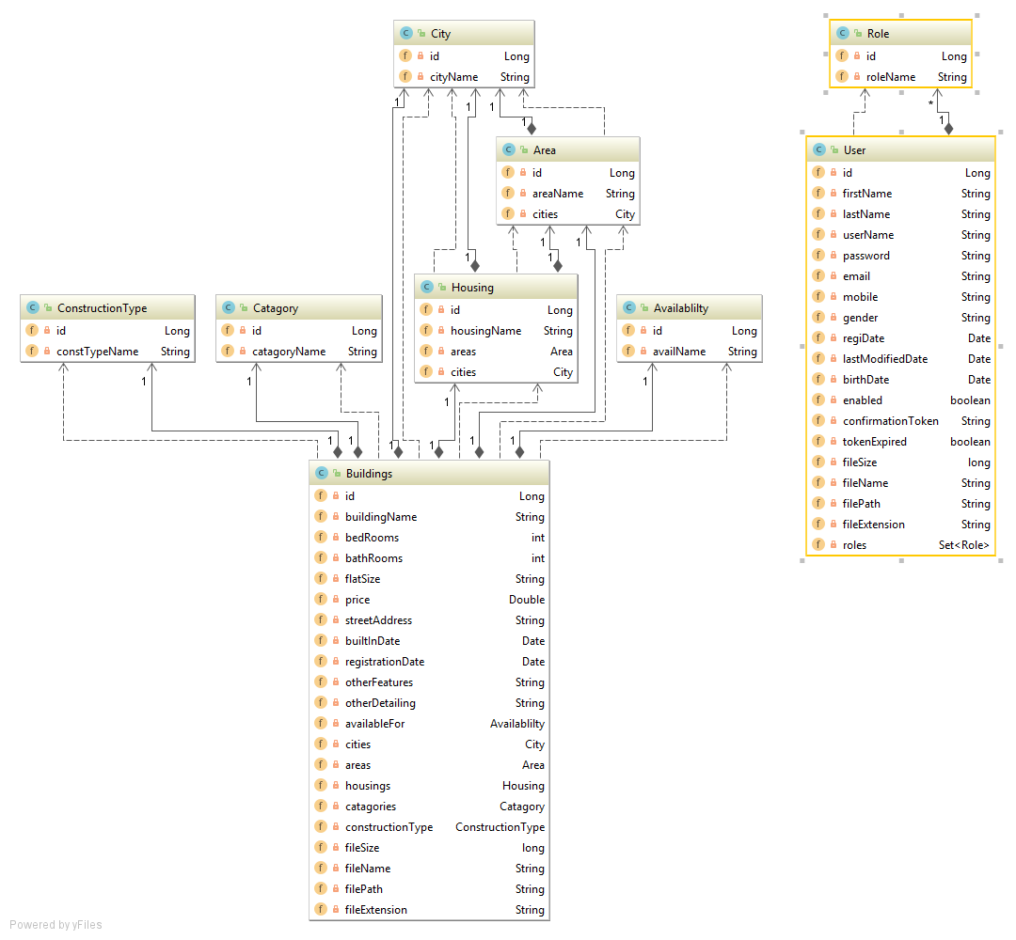
Class diagram detailing

Slide 9
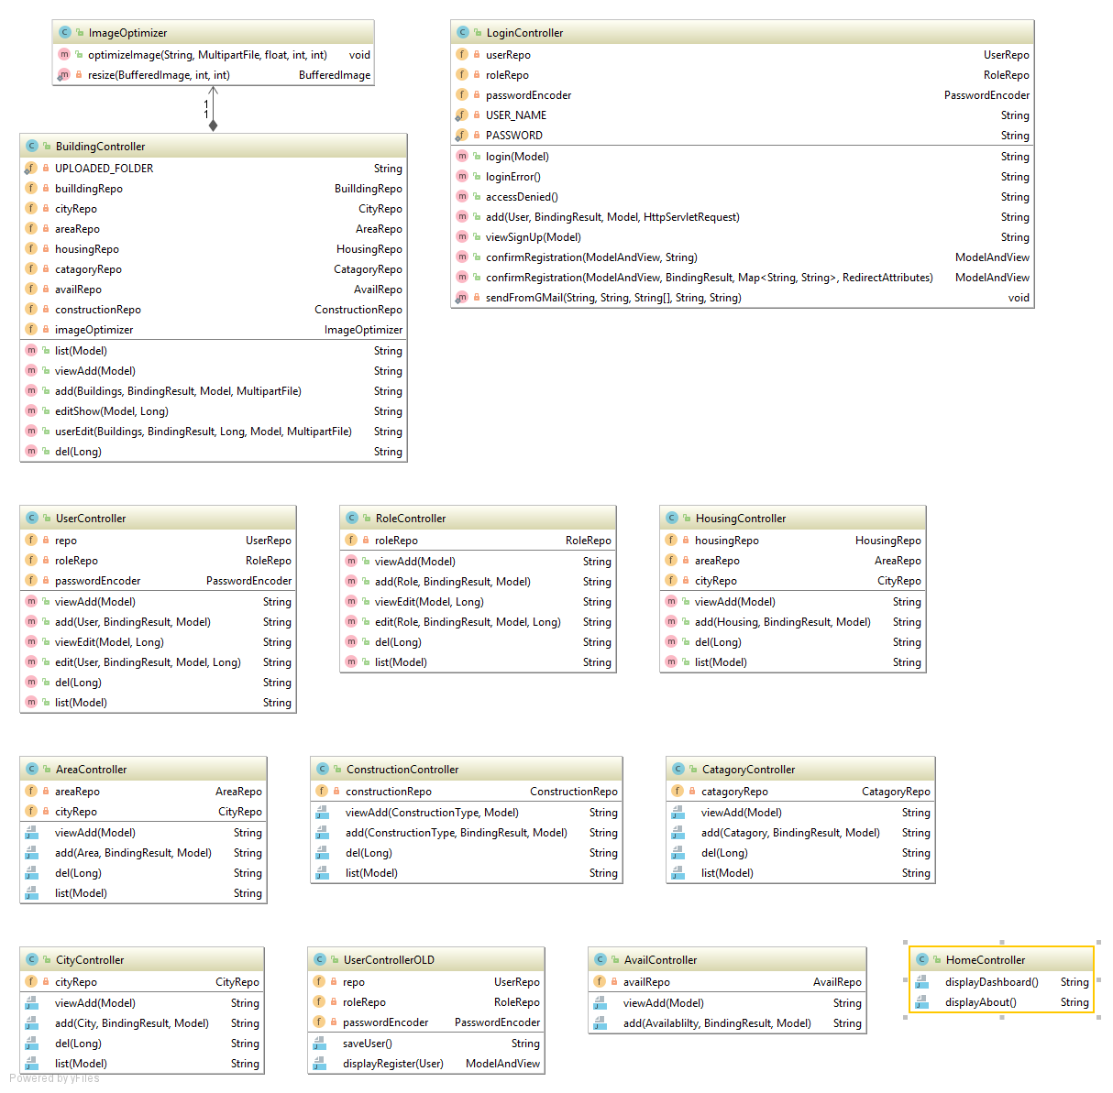
Controllers

Slide 10
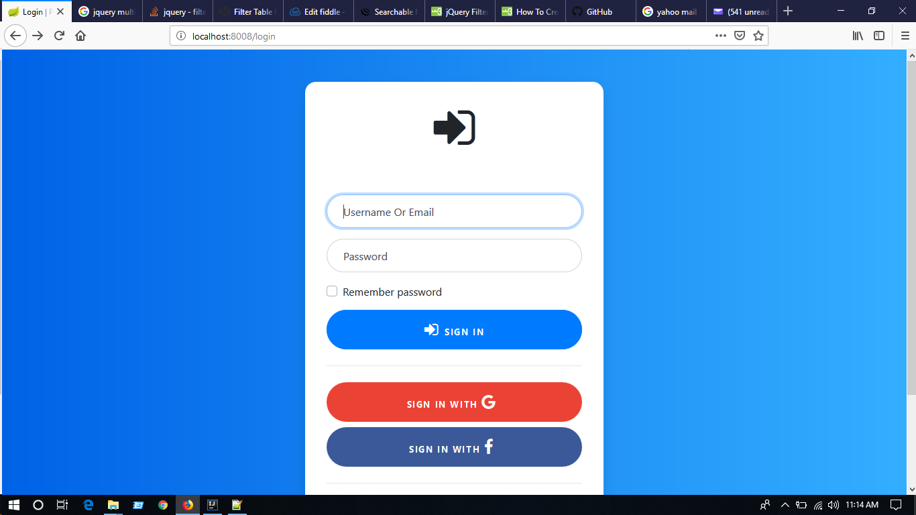
LogIn Page

Slide 11
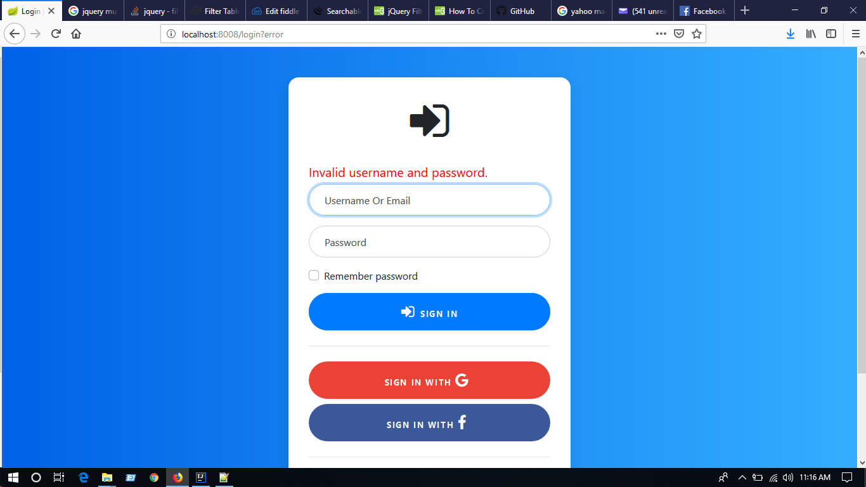
Invalid Login

Slide 12
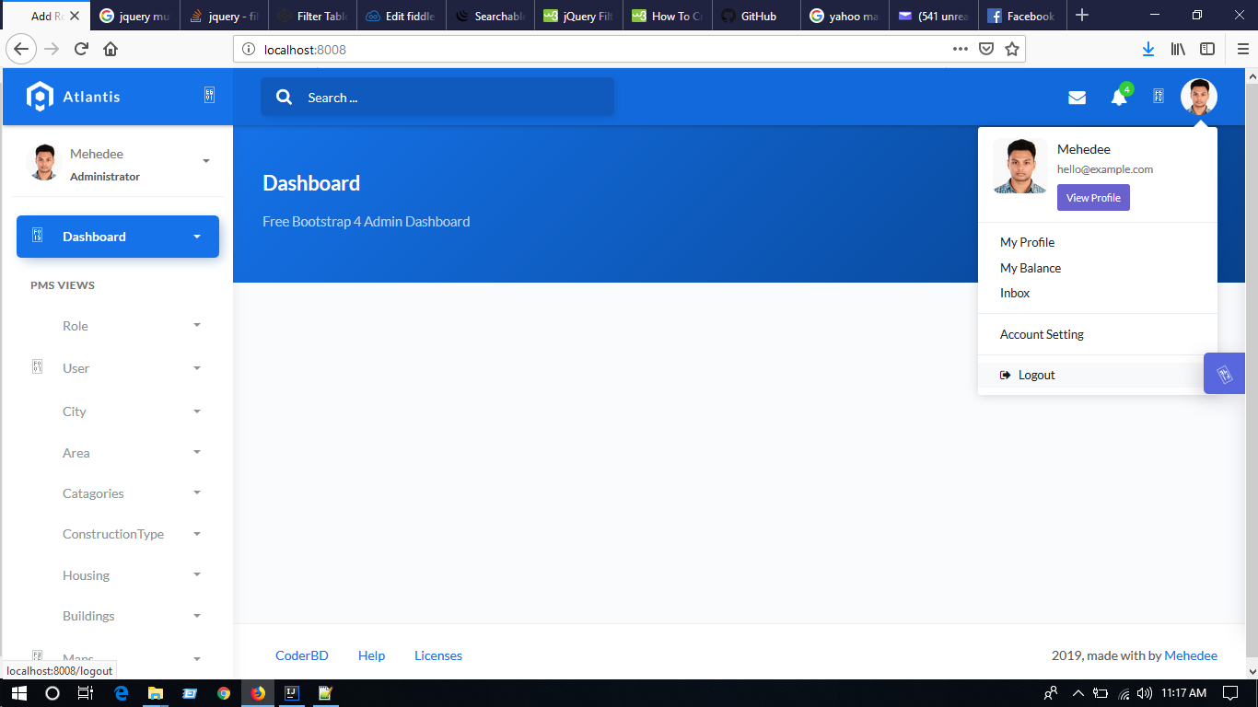
Logout Button

Slide 13

Successful Logout

Slide 14
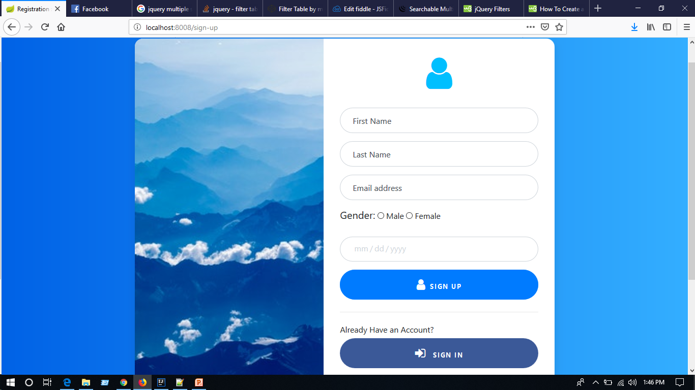
Sing Up Page

Slide 15
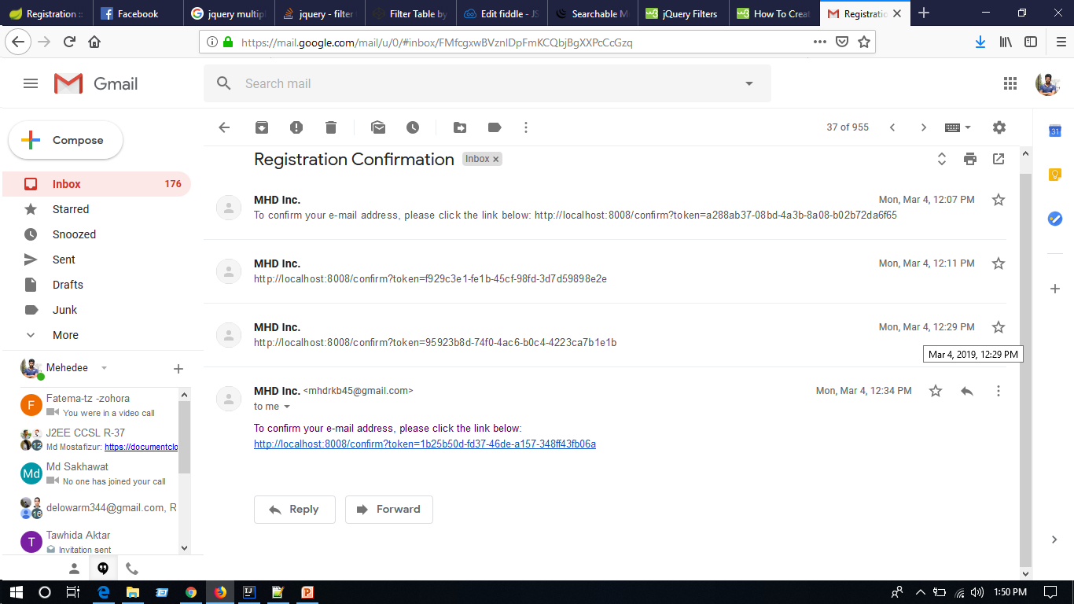
Email Token

Slide 16
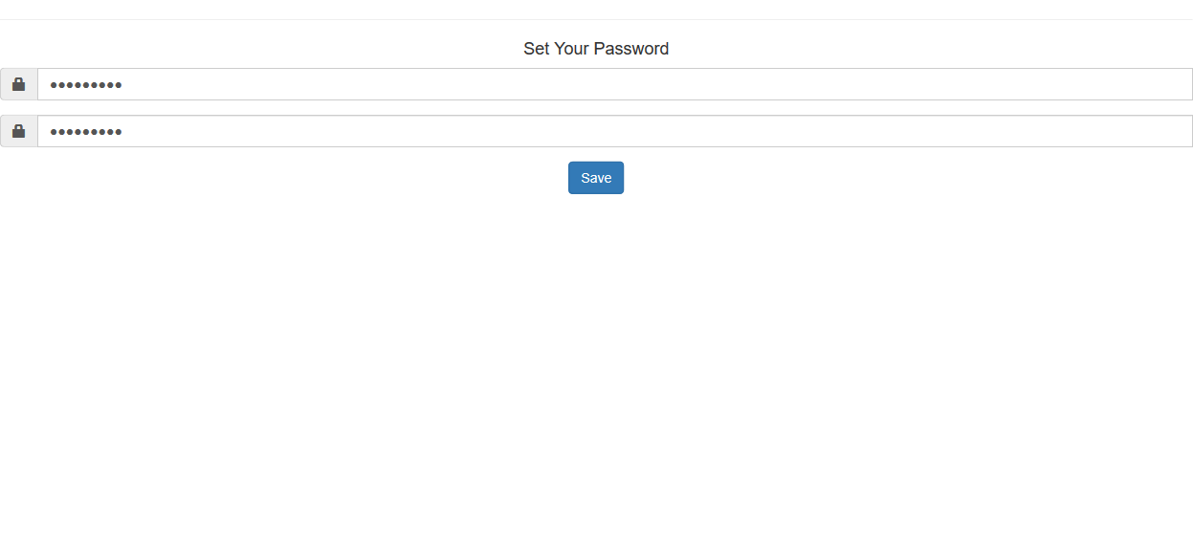
Password Page

Slide 17
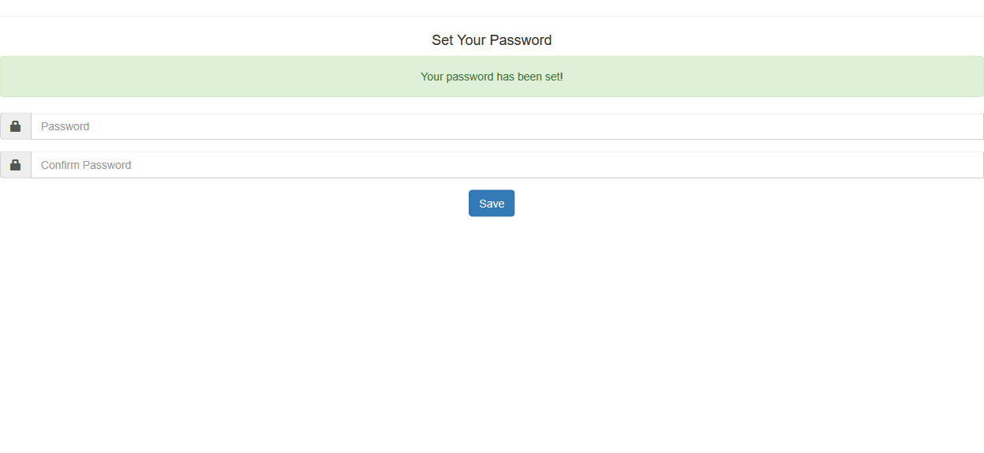
Password Confirmation

Slide 18
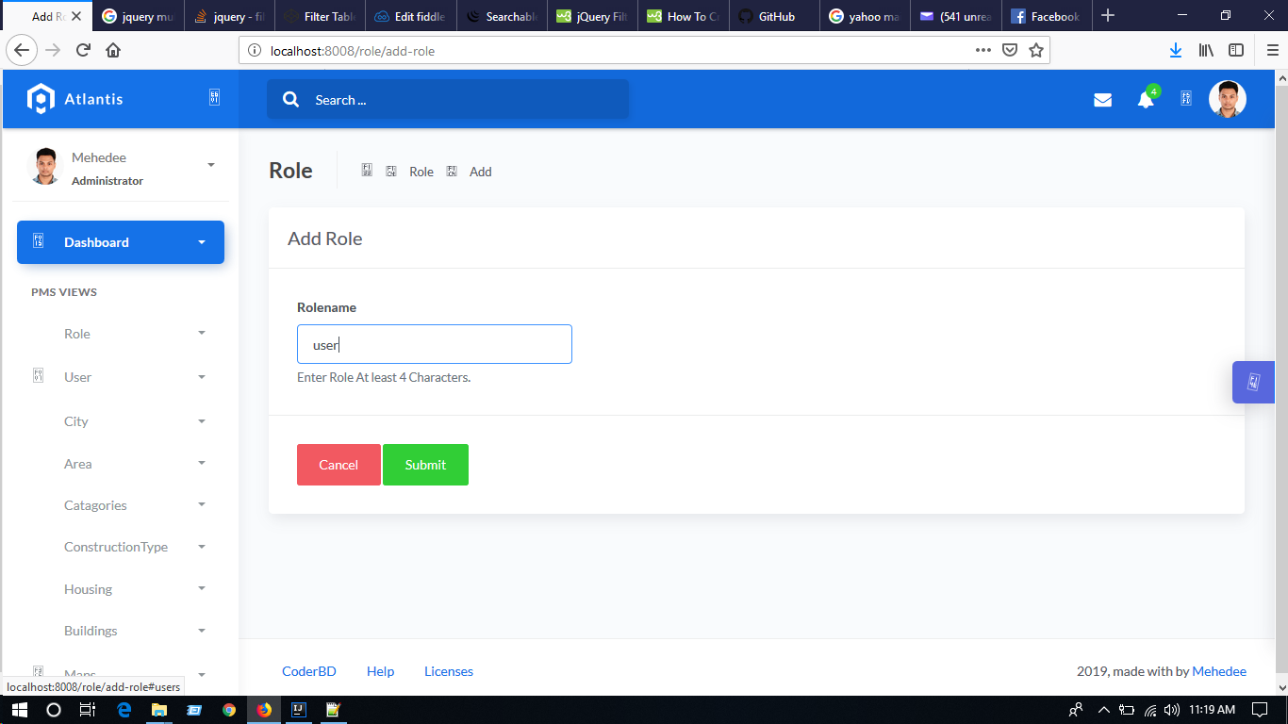
Add Role Page

Slide 19
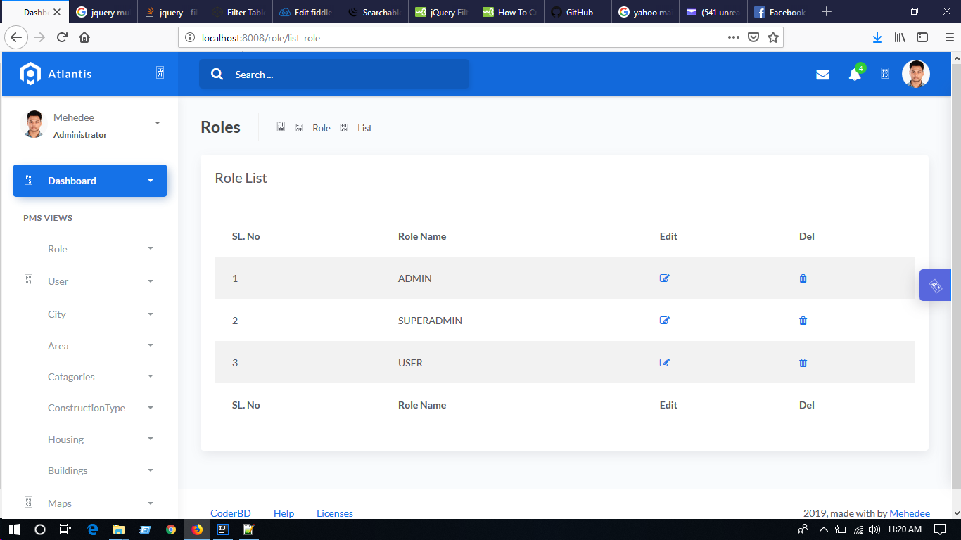
Role List

Slide 20
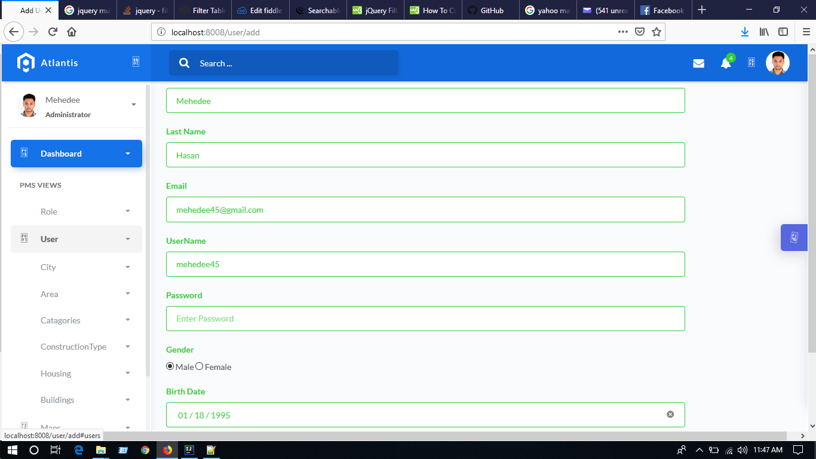
Manual Actor adding

Slide 21
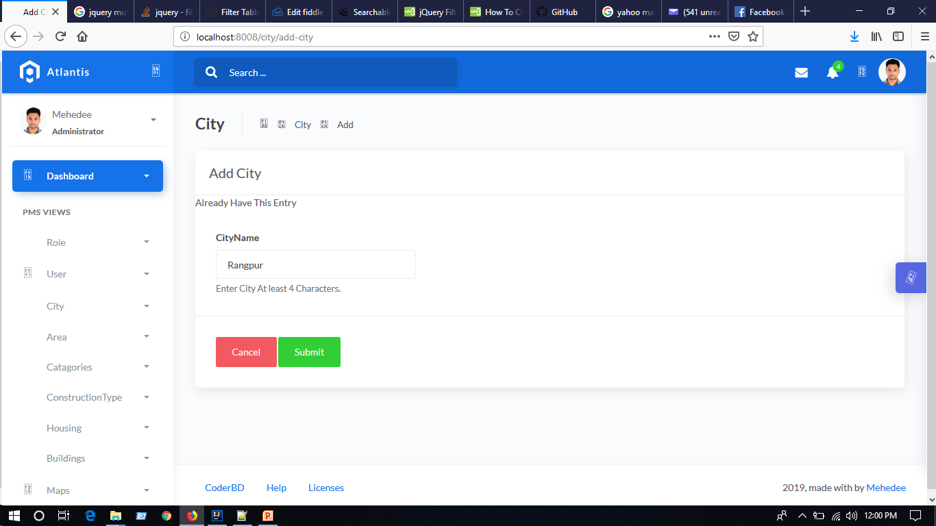
Add City

Slide 22
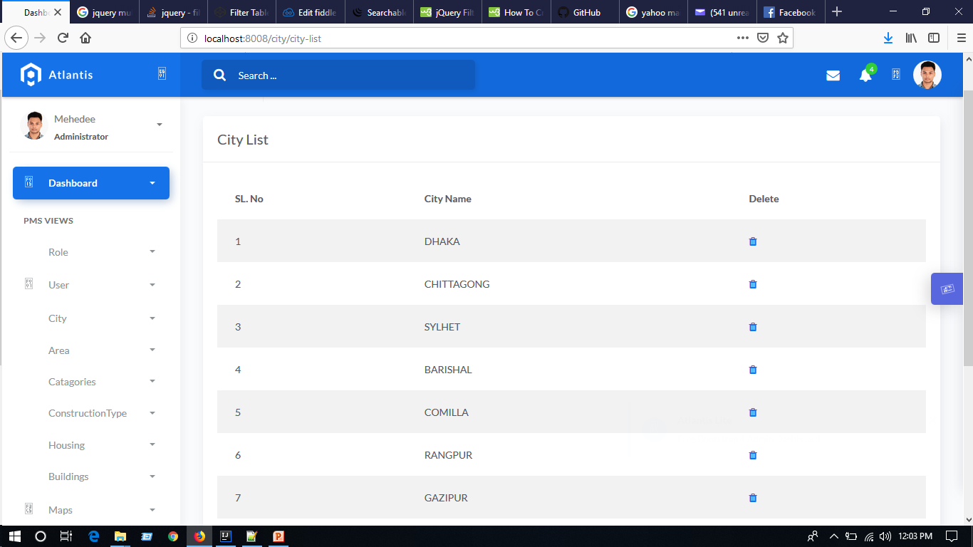
CityList

Slide 23
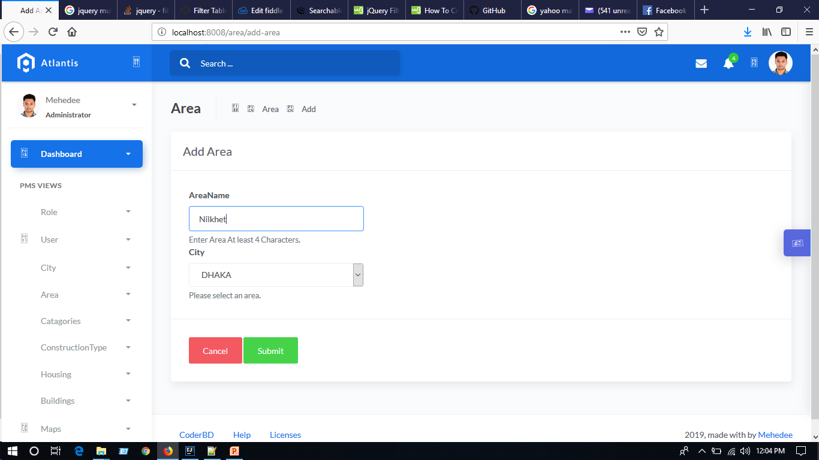
Add Area

Slide 24
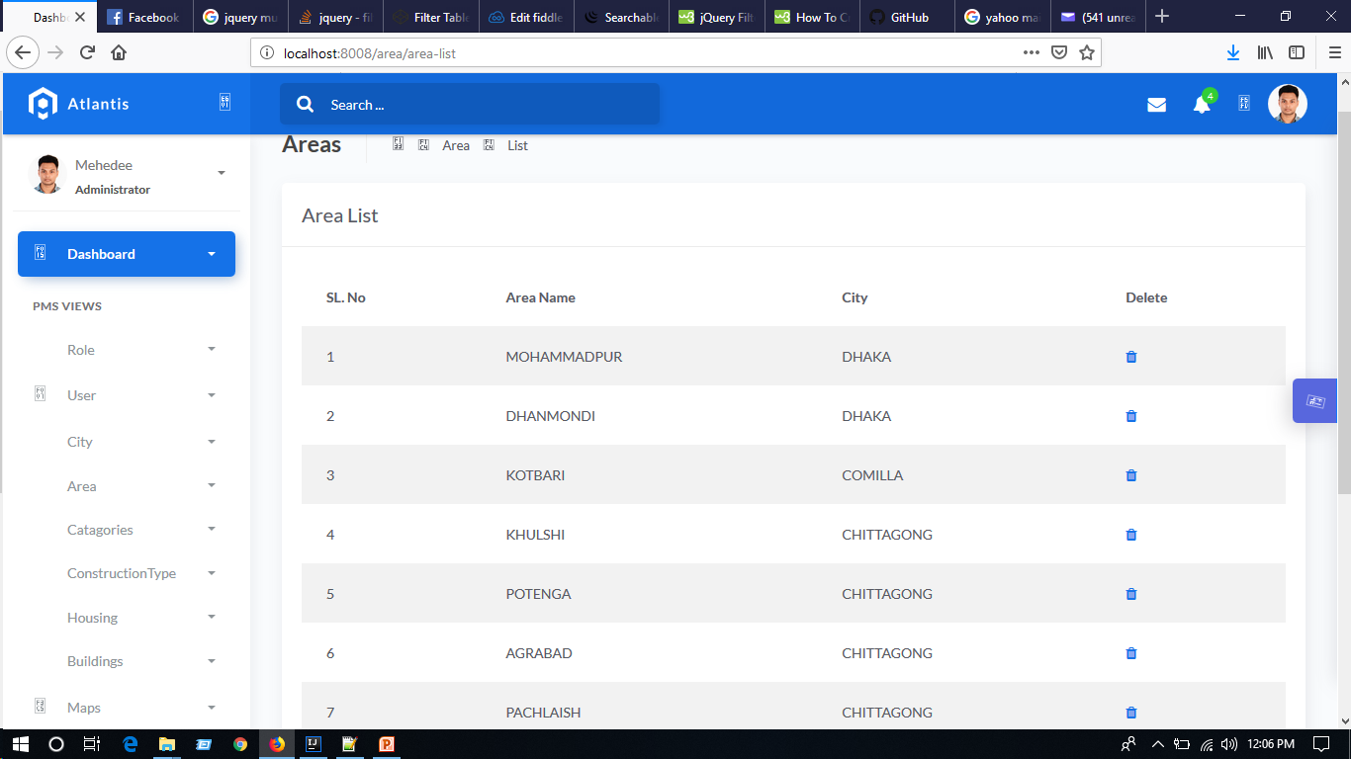
Area List

Slide 25

Add Catagory

Slide 26
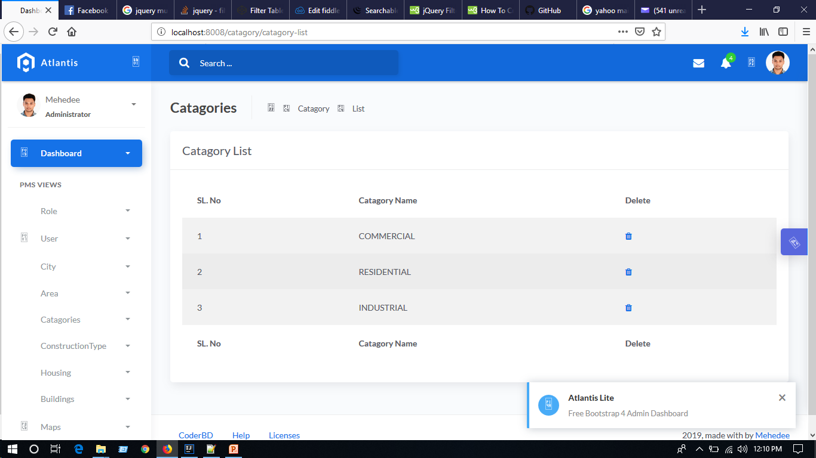
CatagoryList

Slide 27


Slide 28

ConstructionType List

Slide 29
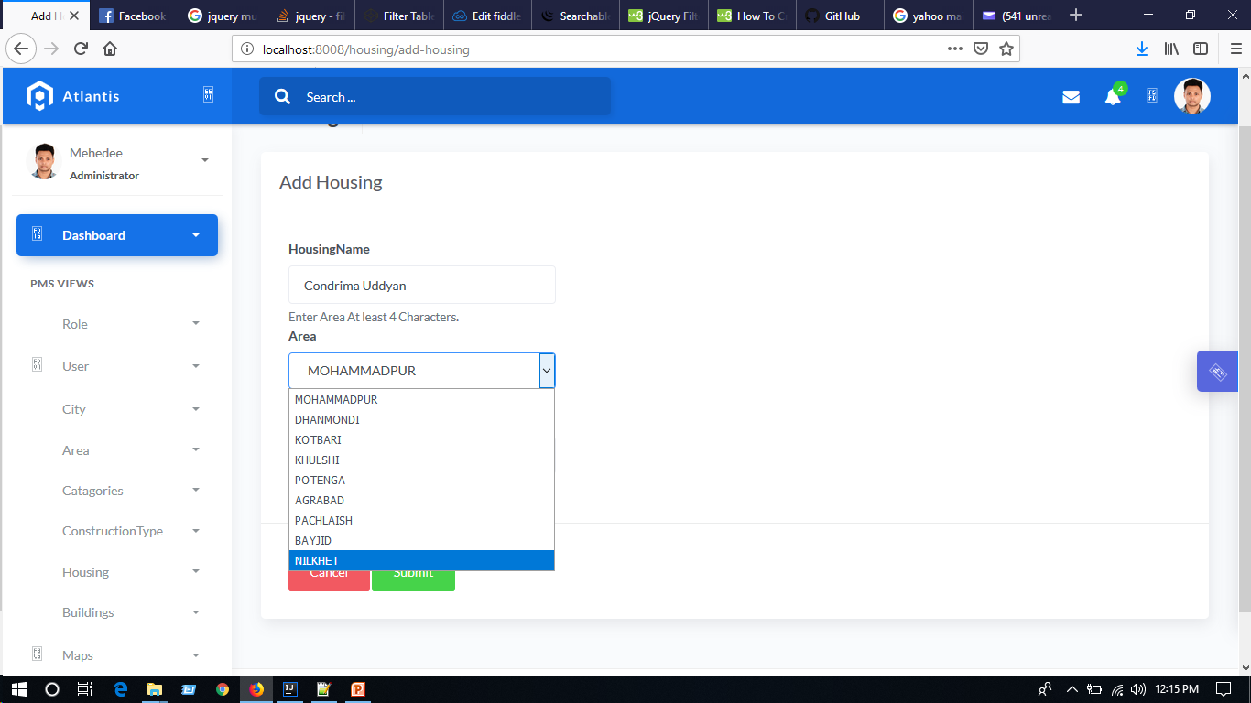
Add Housing

Slide 30
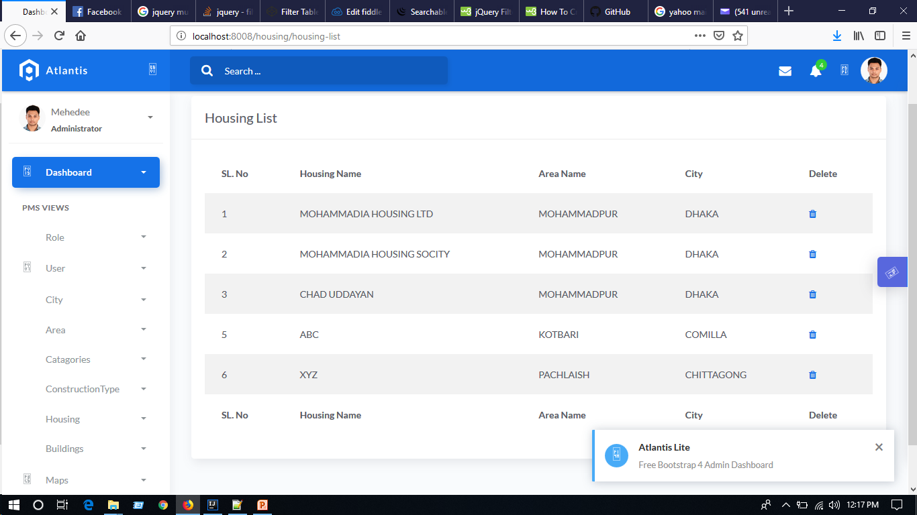
Housing List

Slide 31
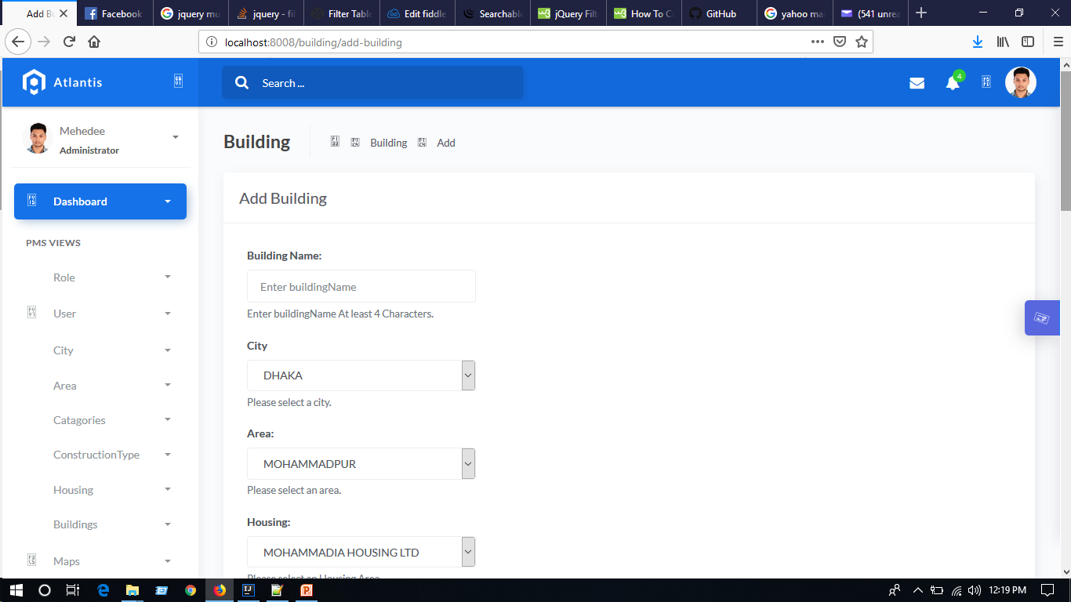
Add building (one)

Slide 32
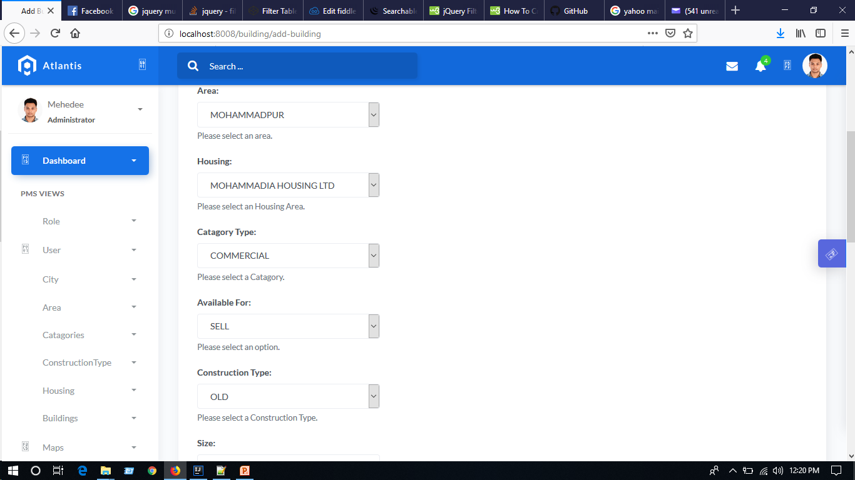
Add Building(two)

Slide 33
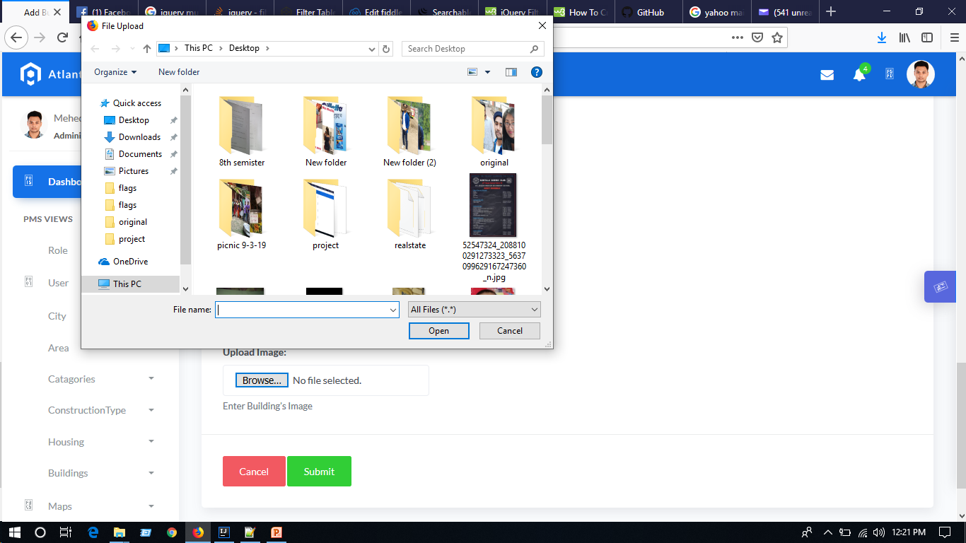

Slide 34
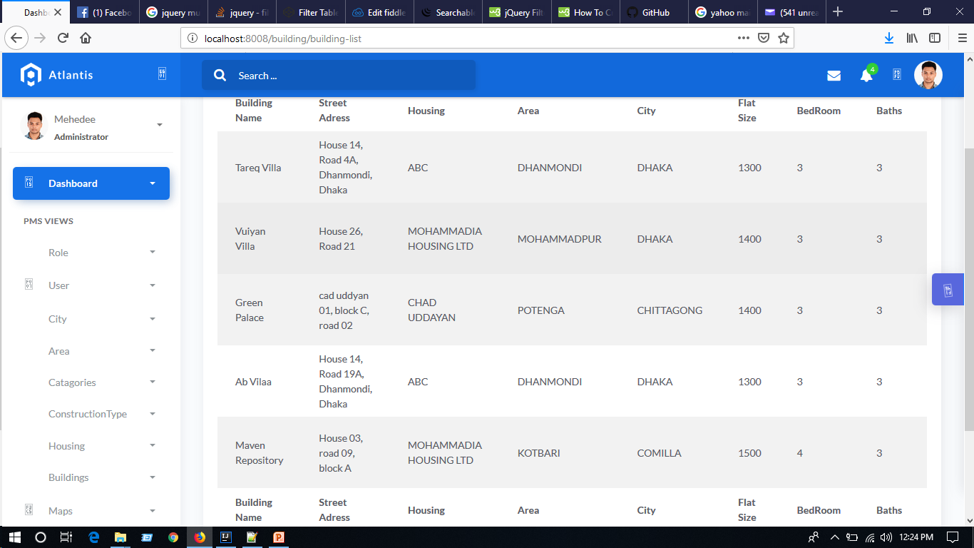
Building List

Slide 35
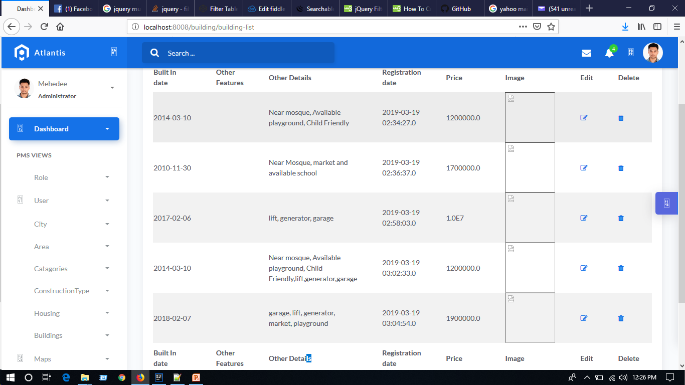
Building List

Slide 36
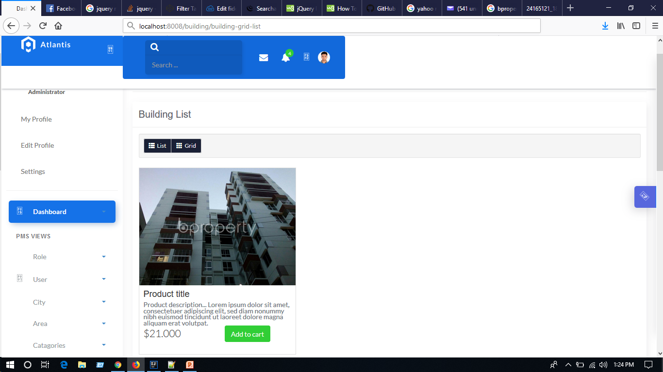
Grid list

Slide 37
Continue To…
Google Map adding
Multiple Image View
Assign an agent from a list with a property against every client’s order.
Email or mobile message to client and agent after placing an order.
Order placement table.
Dashboard for super admin with the feature of graph, list, chart etc..
Strong security…

Slide 38
Thanks For Watching

